Slide 1


DATA
VISUALIZATION
PROJECT
By Group 10:
Imaad Ansari - 21f1004808
Harshitha Srikanth-21f1004861
Yatin Chug -21f1007066
Arram Nithish - 21f1003498

Slide 2
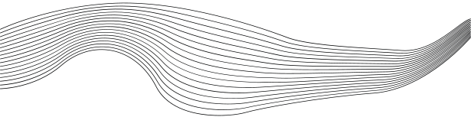
INTRODUCTION
THE FACE MASK DATASET PROVIDES VALUABLE INFORMATION ABOUT THE SALES, CUSTOMER REVIEWS, AND PRODUCT CHARACTERISTICS OF A RANGE OF FACE MASKS SOLD IN DIFFERENT COUNTRIES AND BY DIFFERENT BRANDS.
BY ANALYZING THIS DATA, WE CAN GAIN INSIGHTS INTO THE PREFERENCES OF CONSUMERS FOR DIFFERENT TYPES OF MASKS, AS WELL AS IDENTIFY POTENTIAL OPPORTUNITIES FOR PRODUCT IMPROVEMENT AND MARKETING STRATEGIES.
THIS ANALYSIS CAN BE USEFUL FOR COMPANIES LOOKING TO BETTER UNDERSTAND THEIR CUSTOMERS AND IMPROVE THEIR PRODUCTS TO MEET CUSTOMER NEEDS.

Slide 3
DATATYPES OF THE VARIOUS ATTRIBUTES OF THE DATASET
reviews.tsv file:
abuseCount: ratio
customerNickname: nominal
helpfulNo: ratio
helpfulYes: ratio
id: nominal
imagesCount: ratio
languageCode: nominal
postedDate: interval
productId: nominal
profileInfo.ugcSummary.answerCount: ratio
profileInfo.ugcSummary.reviewCount: ratio
ratingValue: ordinal
reviewText: nominal
reviewTitle: nominal
reviewed: nominal
score: ratio
languageCode.1: nominal
translation.reviewText: nominal
translation.reviewTitle: nominal
Products.tsv file:
product_id: nominal
product_name: nominal
product_price: ratio
price_currency: nominal
product_availability: nominal
product_url: nominal
source_url: nominal

Slide 4
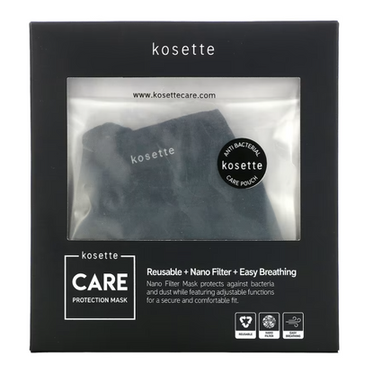
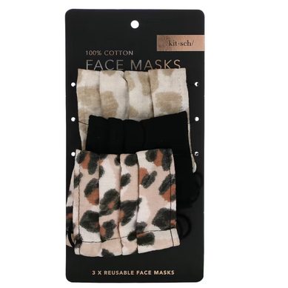
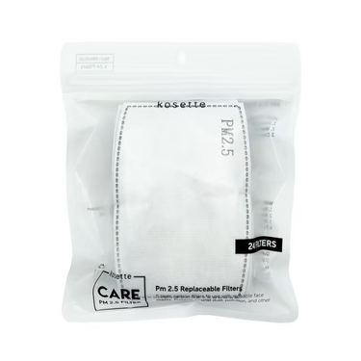
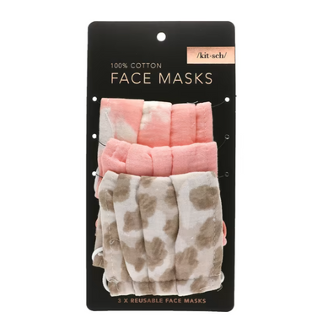
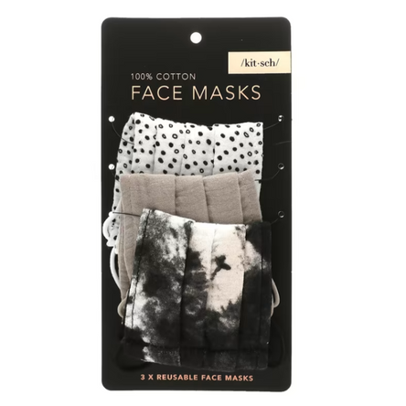

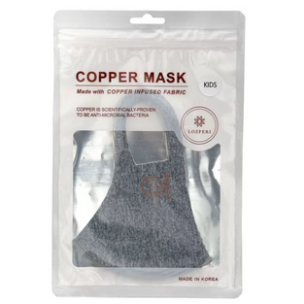

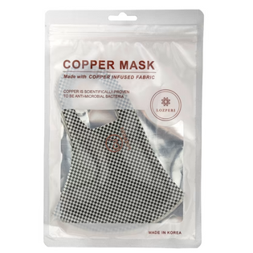
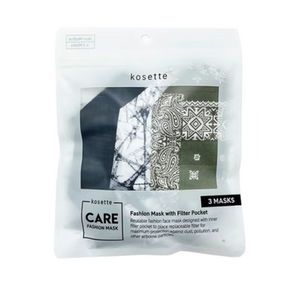
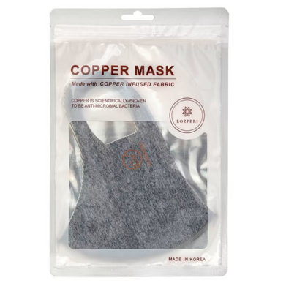
TYPES OF MASKS
REUSABLE MASKS

Slide 5
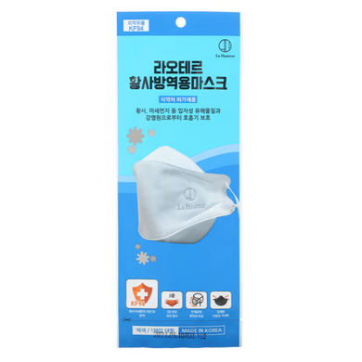
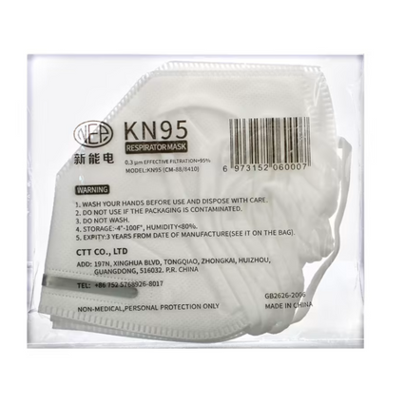
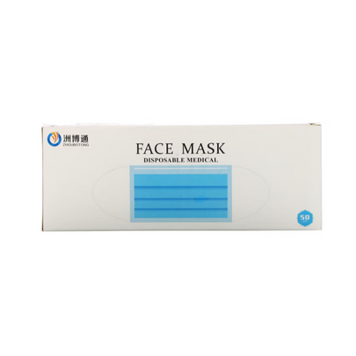
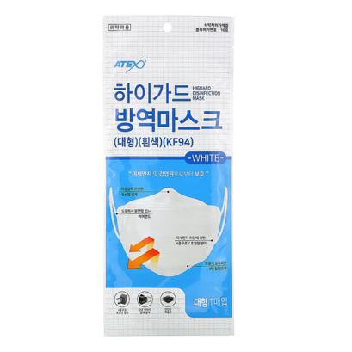


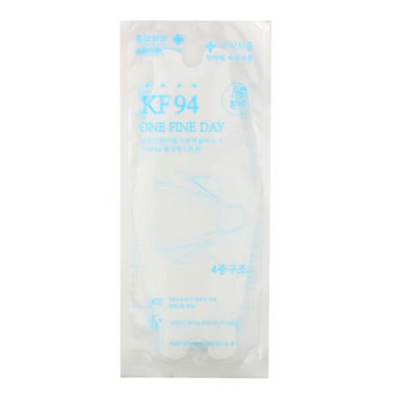


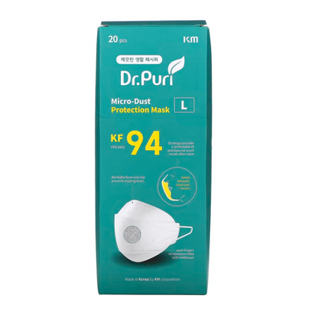
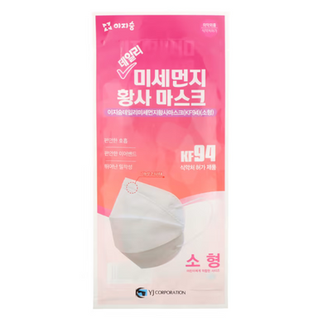
TYPES OF MASKS
DISPOSABLE MASKS

Slide 6
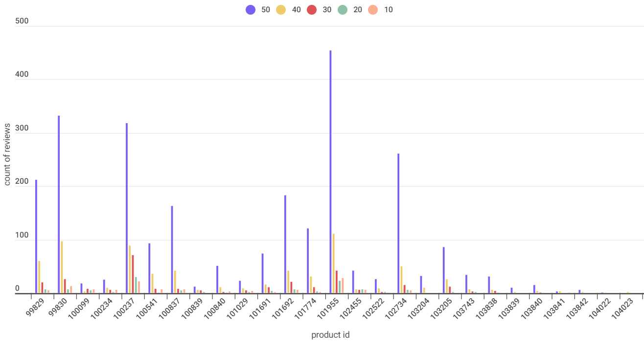
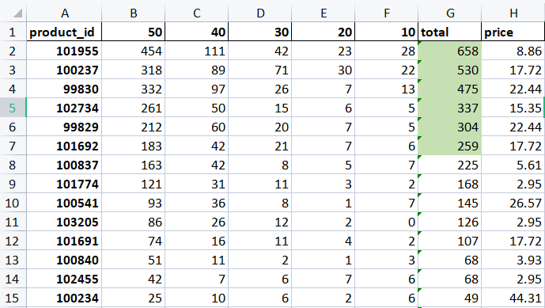
SOME GENERAL VISUALIZATIONS AND INFERENCES FROM THE DATASET
In this table we can see the total reviews per mask and compare their price range with other masks. It is easily observed that these popular masks are not so costly. It is easily affordable.
This column chart compares the reviews of every mask.We can easily observe that 5 masks have total positive reviews(rating 50) more than 200. And with this observation we can say that these are most popular masks.

Slide 7

MOST POPULAR MASKS
Product ID: 101955
Product ID: 100237
Product ID: 99830
and
99829
Product ID: 102734
Product ID: 101692
SunJoy K95,professional protective disposable mask
10 masks
Kitsch 100% cotton resuable mask, leopard
3 masks
Kosette Nano reusable face protection mask
1 mask
Zidian disposable protective mask
50 masks
Kitsch 100% cotton resuable mask, Neutral
3 masks
Price:8.86AUD
Price:17.72AUD
Price:22.44AUD
Price:15.35AUD
Price:17.72AUD

Slide 8
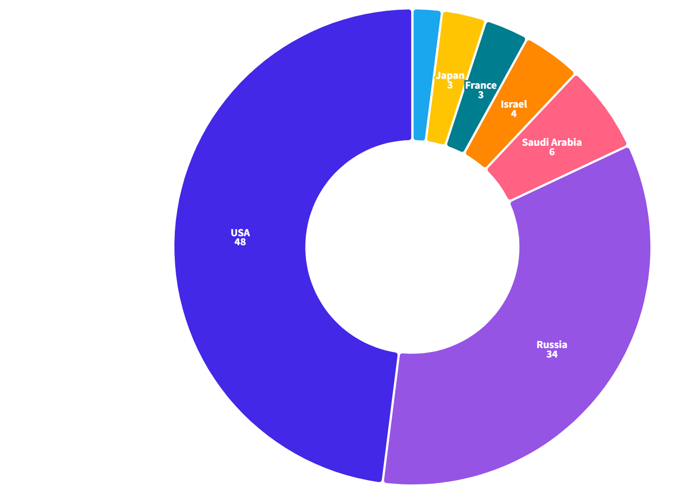
Mask Markets
Majority of sales were made in the USA and Russia, suggesting that these two countries may have the highest demand for face masks.
*The Values are in %
Link

Slide 9
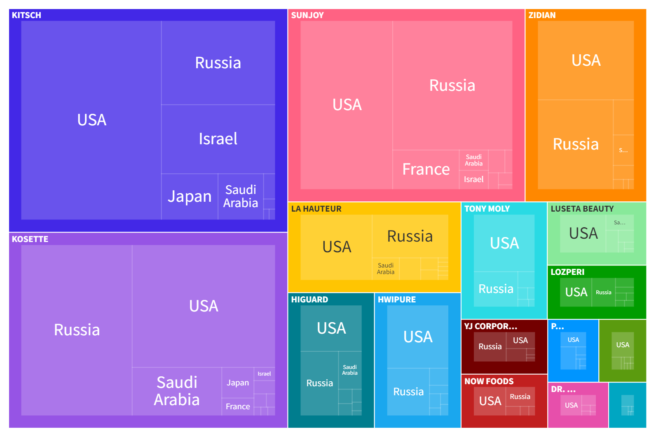
Most commonly used Mask Brands
Kitsch, Kosette and SunJoy dominate the market.
Kitsch has more sales overall, however, Kosette and SunJoy have a bigger market in Russia than Kitsch.
Link

Slide 10
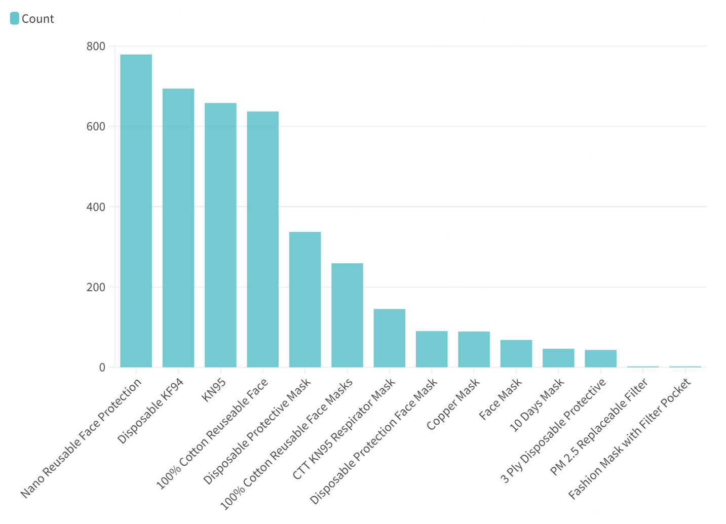
Sales by Mask Type
Higher preference of reusable masks.
Consumers prefer masks that offer high levels of protection.
Link

Slide 11
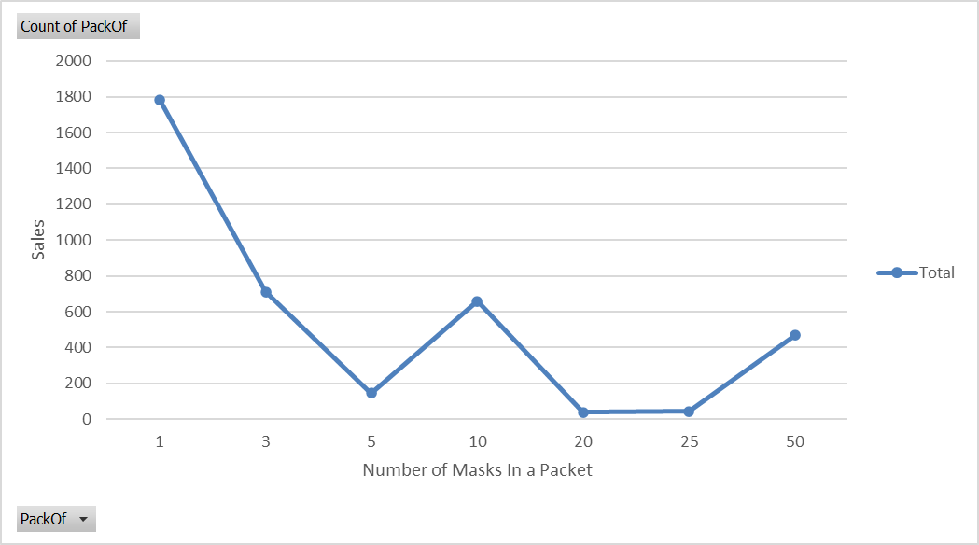
Sales by the number of Masks in a Packet
Brands can price pack of 1 a little higher than others.
Focus of marketing & packaging of packs of 1, 10 and 50.

Slide 12
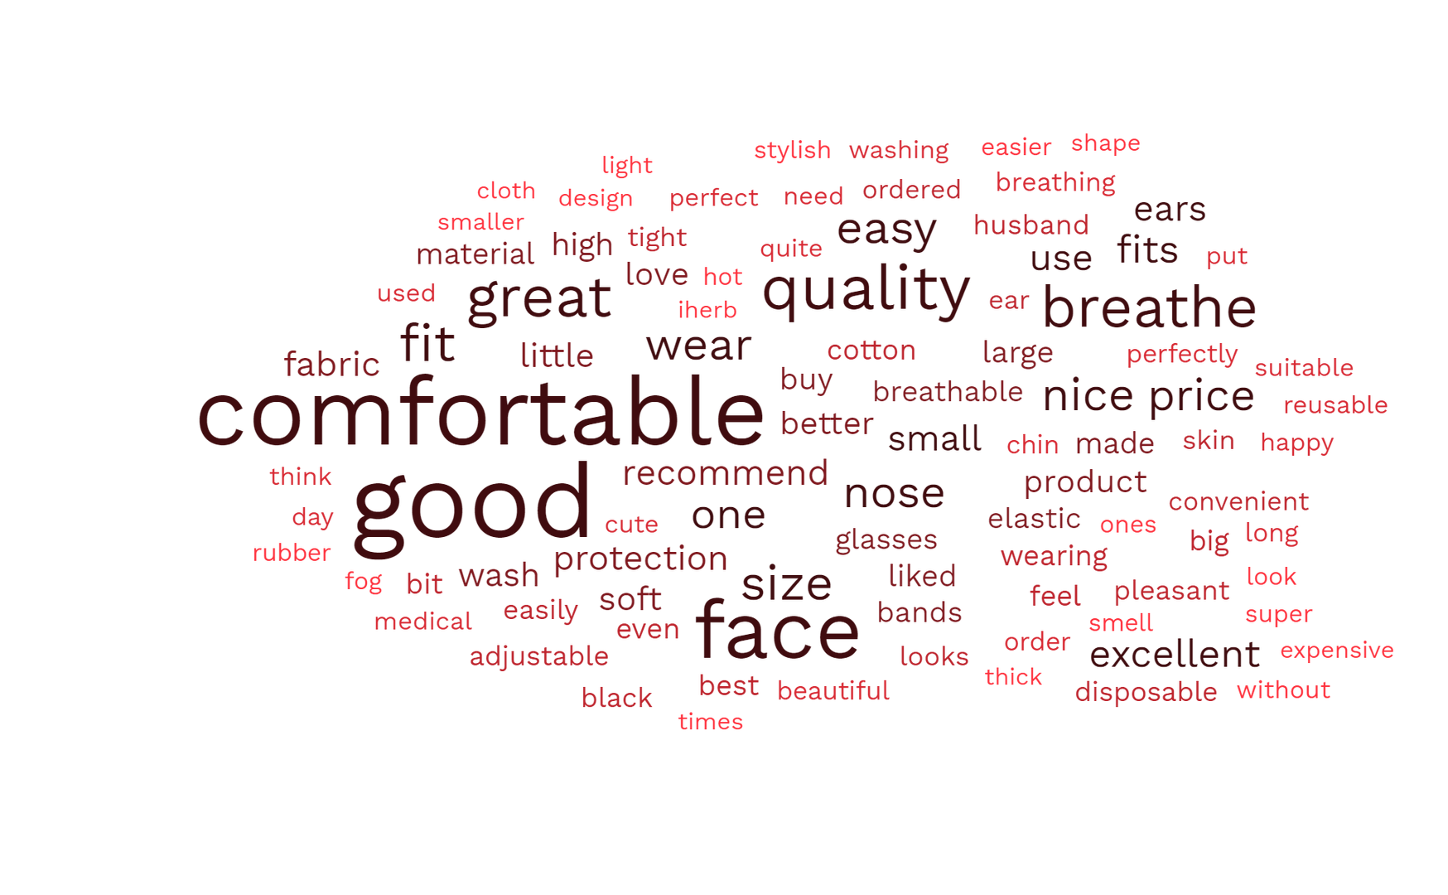
What People Like
Word | Mentions
Comfortable | 785
Quality | 452
Breathable | 400
Fit | 344
Price | 260
90.6% of Reviews are Positive

Slide 13
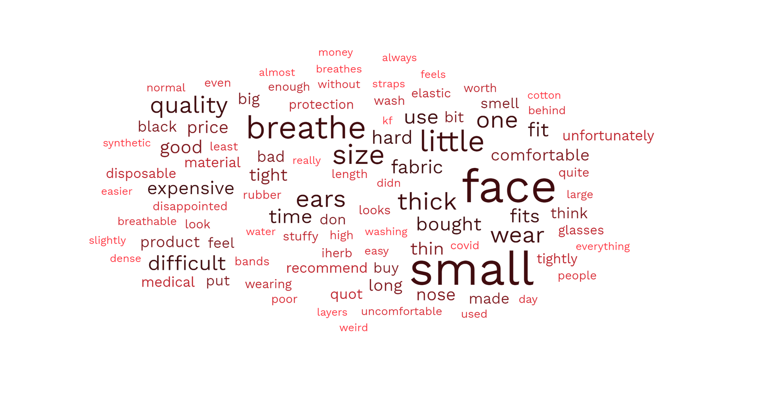
What People Dislike
9.4% Negative Reviews
Word | Mentions
Small | 74
Breathe | 46
Little | 42
Size | 35
Thick | 31

Slide 14
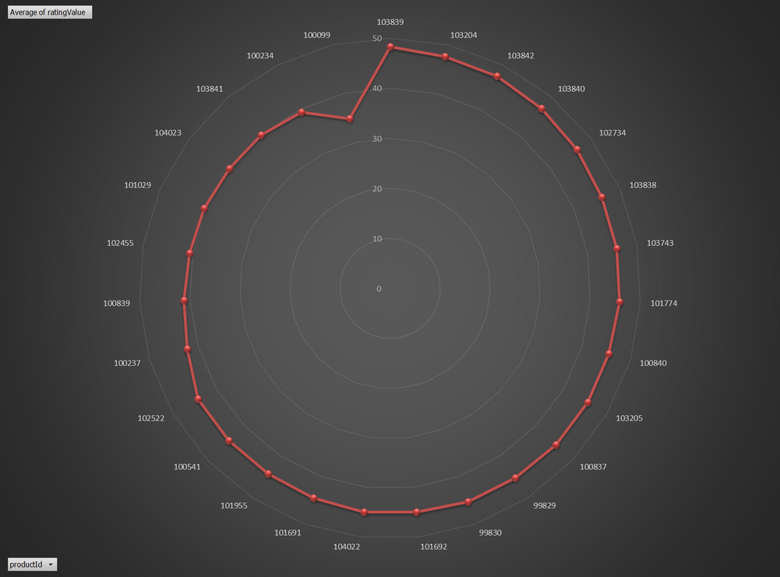
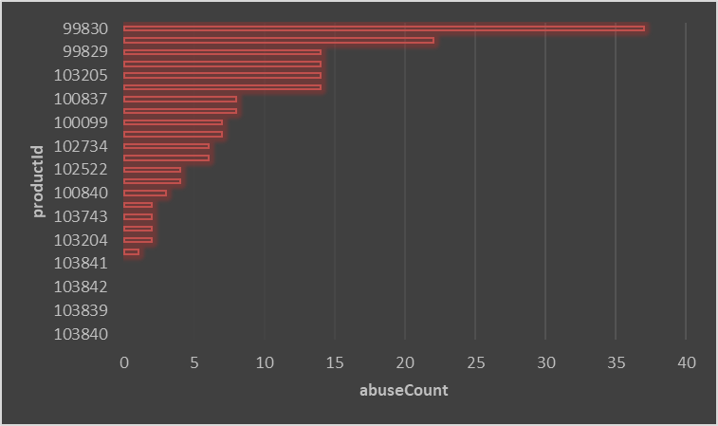
SOME GENERAL VISUALIZATIONS AND INFERENCES FROM THE DATASET
One particular product:(Kosette, Care Protection Reusable Nano Filter Mask)99830 has extremely high abuse counts.
Reasons may include:
Only nano fibre mask in dataset(nano fibre may be uncomfortable)
Fake reviews or coordinated efforts to mark legitimate reviews as abusive.
.
Average ratings of most products ire in the 40+range indicating that most of the products are extremely highly rated and there is no product that is doing very poorly in the market.This is a great sign for customer satisfaction

Slide 15
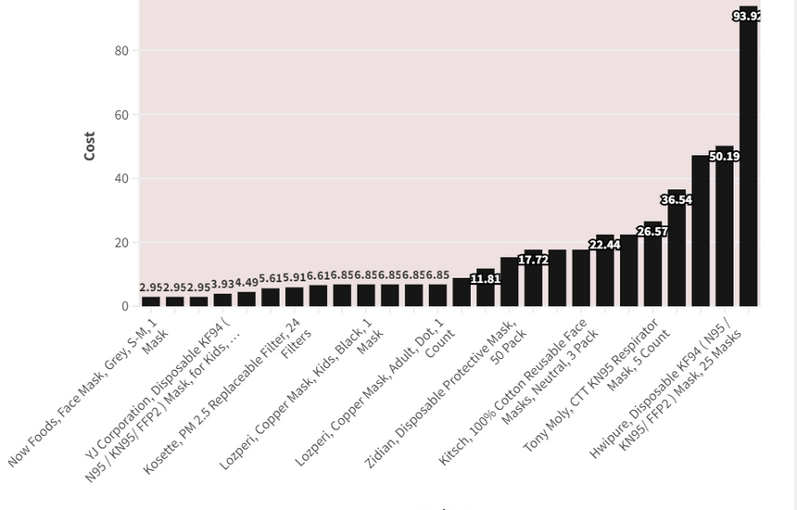
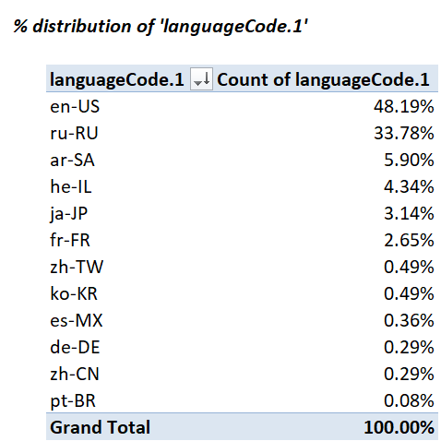
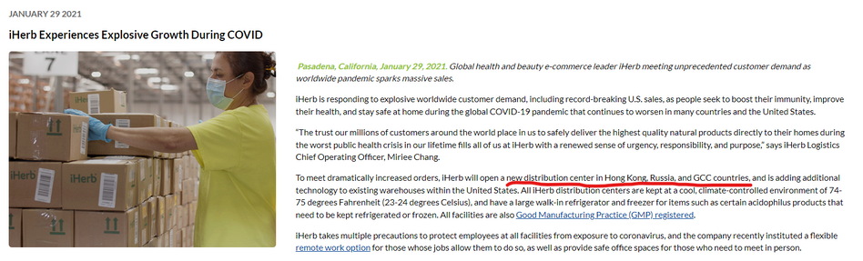
SOME GENERAL VISUALIZATIONS AND INFERENCES FROM THE DATASET
One specific product namely Luseta beauty masks turn out to be extremely expensive in comparison of other masks.On drilling down and analysing why we infer that it was priced so because it was a pack of 50 masks whereas the other masks sold in packs of 10 or 5
Reasons for this trend may include:
Population size
High COVID-19 cases in these regions
Government mandates
Well established brand in US,Russia pre-pandemic

Slide 16
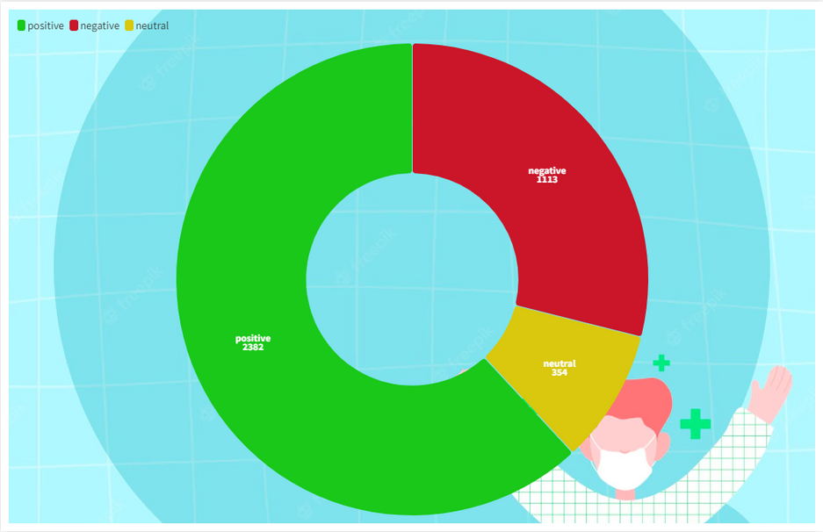
Sentiment analysis using excel-Addins
The majority of the product reviews were positive (2382 out of 2,849), indicating that the customers were generally satisfied with the product.
There were significantly fewer negative reviews (1113 out of 2,849) than positive reviews, which suggests that the product may have a generally positive reputation among customers.
The presence of neutral reviews (354 out of 2,849) indicates that some customers may not have had strong feelings towards the product, and their opinions were more neutral in nature
On performing sentiment analysis over the reviews we can clearly observe that majority of the reviews are positive implying iherb earns itself a lot of happy customers

Slide 17
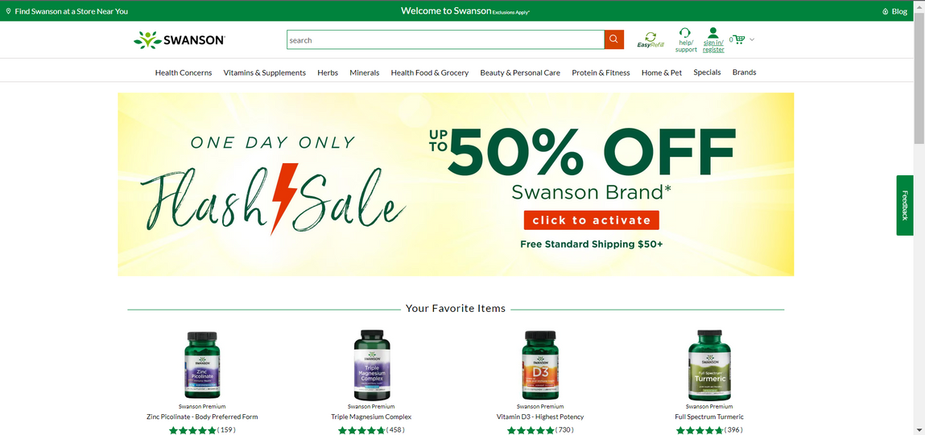
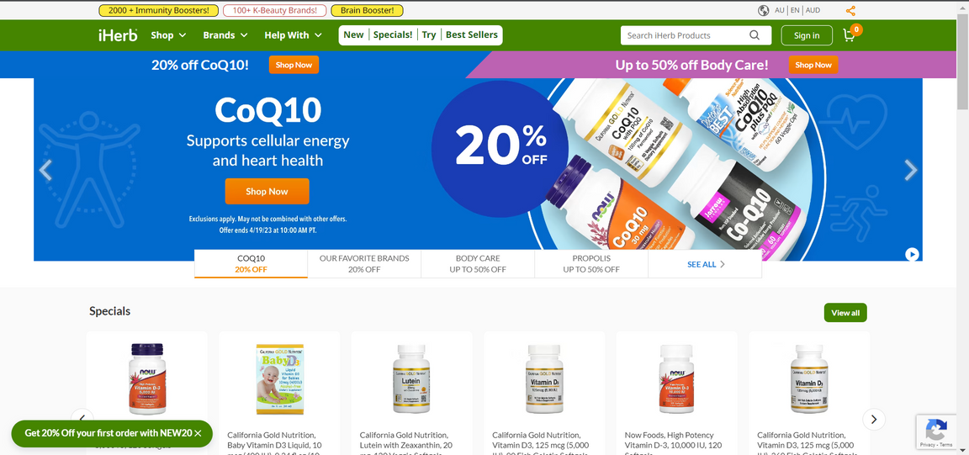
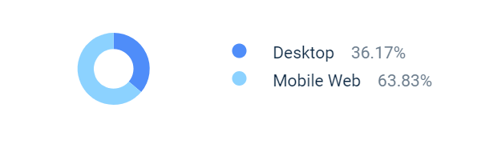
A comparison between a iherbs website and a better designed swansons page
https://au.iherb.com/
https://www.swansonvitamins.com/
Device distribution
Another metric to consider is that iHerb.com have a bounce rate of 51%In other words, they "bounce" from the website without exploring any further. A high bounce rate is generally considered to be a negative indicator, as it suggests that visitors are not finding what they are looking for on the website, or they are not engaged enough to explore the site further.

Slide 18
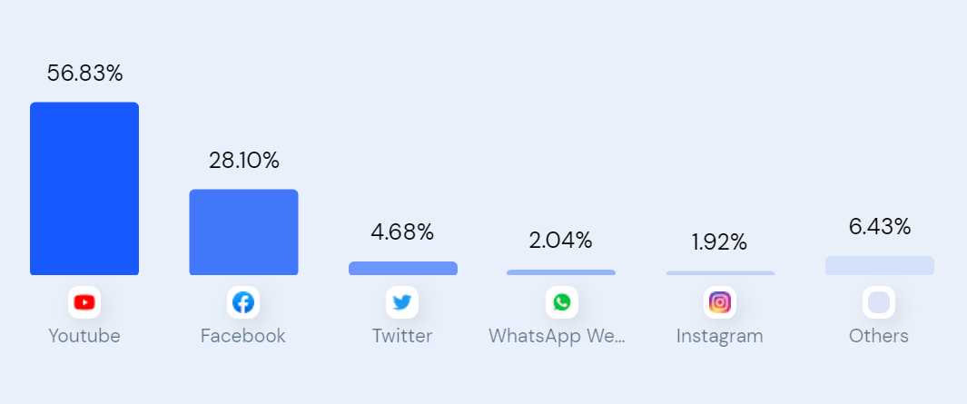
A deep dive into iHerbs social media presence
Some insights we can infer are:
iHerb has an extremely poor presence on instagram making it an untapped marked.
Some advantages of Instagram over youtube may include:
Targetted advirtising
Shorter form content:One glance stories/posts
No option to skip-ads
https://www.similarweb.com/website/iherb.com/

Slide 19
Understanding Reviews

Slide 20
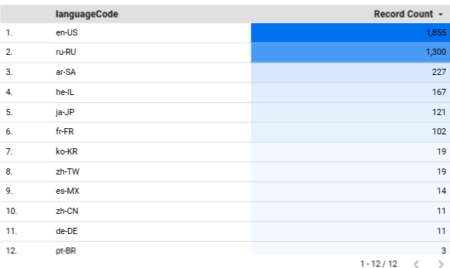
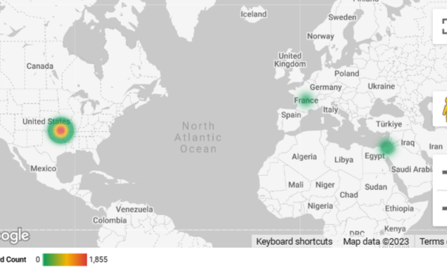
Distribution of Reviews
As we can see there are total of 12 languages used in reviews, while most of the are in English or Russian and the least being Brazillian Portugese
By comparing the reviews by language code we can find out the customer attraction across regions

Slide 21
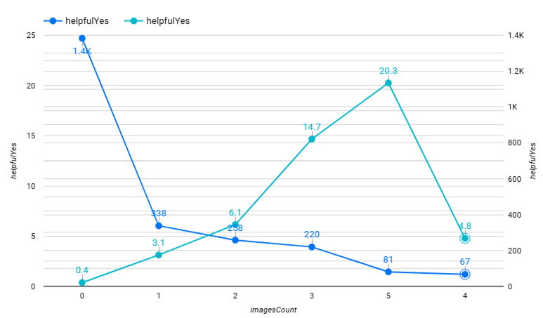
Helpful Reviews vs Imagecount
In this visualization we tried to compare the image count and the review being helpful
During the findings we observed that when we compare the sum of helpful yes votes with image count we see images with 0 images got most helpful votes
But in contray we observed that the average helpful yes count is directly propotional to the image count in the reviews
left axis : average of helpful yes
right axis: sum of helpful yes counts

Slide 22
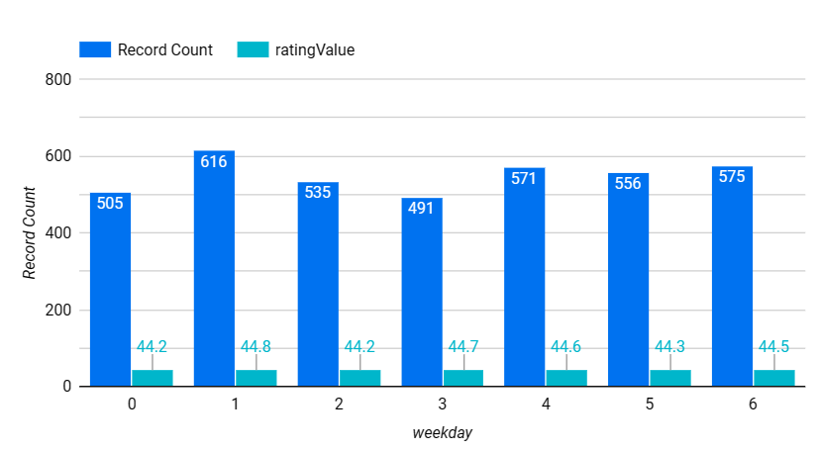
Day of week
This visualization compares
the number of reviews and
rating score acorss days
of the week
we can see that most reviews
are on monday whie least
is on the mid of the week
wednesday
This helps companies to
see the user engagement over
the days of the week
0- sunday, 1- monday
2-tuesday, 3- wednesday
4- thirsday, 5-friday,
6-saturday

Slide 23

Hierarchy visualization
This visualization can help companies understand the market by providing a clear overview of their products, competitors' products, and what customers are saying about them.
By analyzing this information, companies can identify patterns and trends, such as which types of masks and pack sizes are most popular, which competitors are offering similar products, and what customers like.
This can help companies make data-driven decisions about their product development, marketing, and sales strategies, which can lead to better customer satisfaction and increased revenue.
Additionally, the filter for language used can help companies identify areas where they need to improve their language support and customer service.

Slide 24
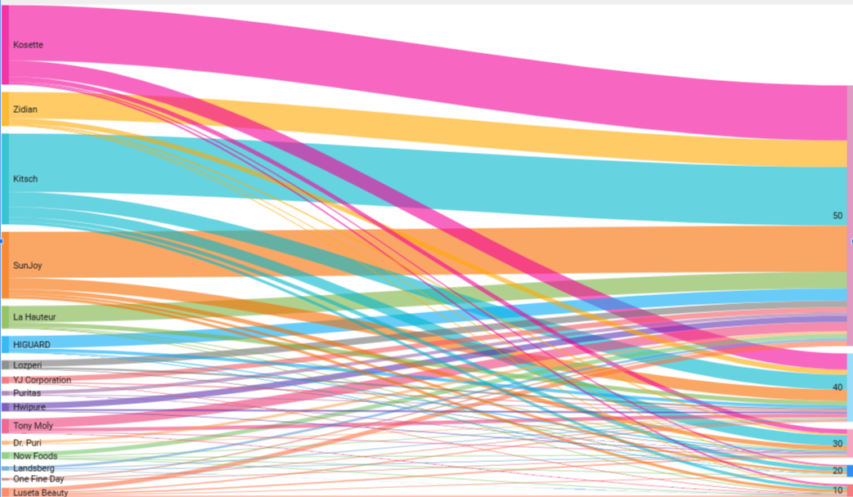
Flow of brand rating by time helps to understand the journey of the brand
Sankey diagrams are a type of visualization that show the flow of data, energy, or other resources through a system. They use arrows of varying widths to represent the magnitude of the flow and show how inputs are transformed into outputs. Sankey diagrams are useful for identifying inefficiencies or bottlenecks in a system

Slide 25
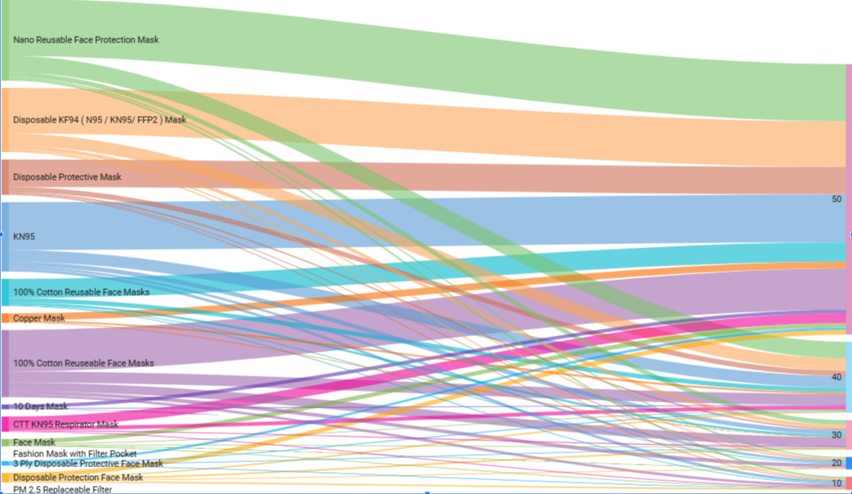
Flow of user rating by time with respect to type of mask helps to understand the user behaviour
Sankey diagrams are a type of visualization that show the flow of data, energy, or other resources through a system. They use arrows of varying widths to represent the magnitude of the flow and show how inputs are transformed into outputs. Sankey diagrams are useful for identifying inefficiencies or bottlenecks in a system

Slide 26
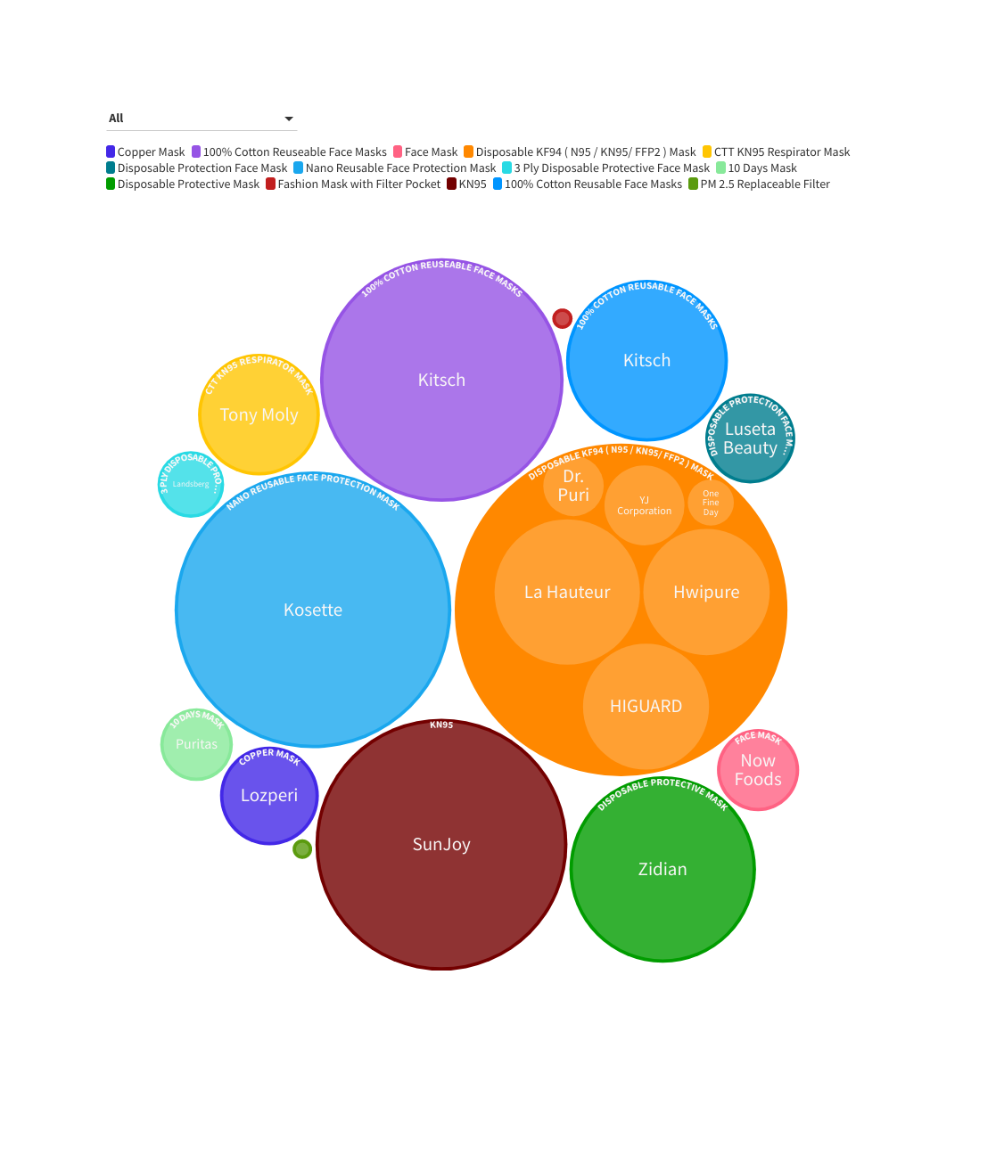
Hierarchy graph
This visualization explains among the type of masks available which brand manufactures them and the rating comparison in that type of masks
Circular hierarchy graphs, also known as sunburst charts or multi-level pie charts, are a type of visualization that displays hierarchical data using nested circles. Each circle represents a level in the hierarchy, with the innermost circle representing the root node and the outermost circle representing the leaves. The area of each segment is proportional to its value, making it easy to compare the relative sizes of each category. These charts can be useful for visualizing the breakdown of a larger category into subcategories, or for exploring the relationships between different levels in a hierarchy.

Slide 27
How can additional data sources be used to gain more insights into the type of consumers buying different face masks?
Demographic data like age, gender, income, and location helps to understand consumer preferences. Analyze reviews by different groups and find patterns or differences in feedback, such as younger consumers preferring colorful designs and older consumers preferring plain masks.
Social media data to monitor and analyze conversations and sentiment around different face masks on platforms such as Twitter, Facebook, and Instagram. Using sentiment analysis tools to understand overall sentiment and identify trends and patterns in feedback.
Website Analytics: we can use website analytics to understand how consumers are interacting within face mask product pages. We can analyze data such as page views, bounce rates, and conversion rates to see how different types of consumers are engaging with the products. For example, we might find that consumers in certain locations are more likely to view the face mask products, or that consumers who visit the site on mobile devices are more likely to make a purchase.

Slide 28
How can additional data sources be used to gain more insights into the type of consumers buying different face masks?
Changes in laws in different countries can have a significant impact on businesses. These changes may create new opportunities, such as expanding into new markets or creating new products, or they may pose challenges, such as compliance with new regulations or changes in supply chain logistics.
Past COVID cases data can provide insights into how consumer behavior has changed during the pandemic, and how it might continue to change in the future. By analyzing the correlation between COVID cases and face mask sales, businesses can identify trends and patterns that could inform future product development and marketing strategies.
For example, if there is a correlation between increase in COVID cases and increase in demand for certain types of face masks, businesses can adjust their inventory and production accordingly. Additionally, analyzing the sentiment of reviews during periods of high COVID cases versus low COVID cases can provide insights into how consumer attitudes and preferences are changing, and help businesses to stay ahead of the curve.

Slide 29
Thankyou!
A Presentation by Group 10

